Slide 1
Adults with Diplopia
A few pointers
Shelagh Baynham
Head Orthoptist & Head of Optometry
Non-medical Clinical Lead for Ophthalmology
Wolverhampton Eye Infirmary

Slide 2
Refresher:
Interpreting Eye Movements
Cranial nerve palsies
Red flags
What makes a good (vs poor) referral
Community Management of adult diplopia patients

Slide 3
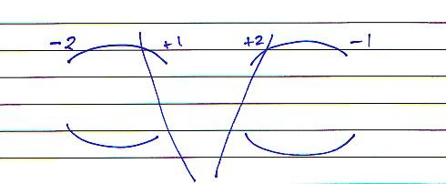
Interpreting Eye Movements
Ocular Movements
Which muscle is
under-functioning to
the greatest extent?
What direction of gaze is most
affected?
Restriction
Updrift

Slide 4
Hering’s law of equal innervation
States that paired agonist muscles from each eye operating in the same field of gaze receive equal innervation while paired antagonist muscles receive equal inhibition.
Sherrington's law of reciprocal innervation
When a muscle contracts, its direct antagonist relaxes to an equal extent allowing smooth movement.

Slide 5
Where do we go from here?
Neurogenic? Mechanical?
Recent onset? Longstanding?

Slide 6
Cover Test:
Near & Dist:
Slight exophoria with good recovery
Near: Slight exophoria with good recovery
Dist: Small esophoria with good recovery
Far Dist: Slight LCS with diplopia

Slide 7
D > V
D > V
Ductions > Versions
Suggestive of neurogenic defect
Ductions = Versions
May be suggestive of mechanical defect
D = V

Slide 8
+2 **
-2 *
-2 ****
+2 ***
Muscle Sequelae
Primary under-action
Over-action of the contralateral synergist
Contracture of the ipsilateral antagonist
Secondary inhibition of the contralateral antagonist
Left SR *
Hering’s Law
Right IO **
Left IR ***
Sherrington’s Law
Right SO ****

Slide 9
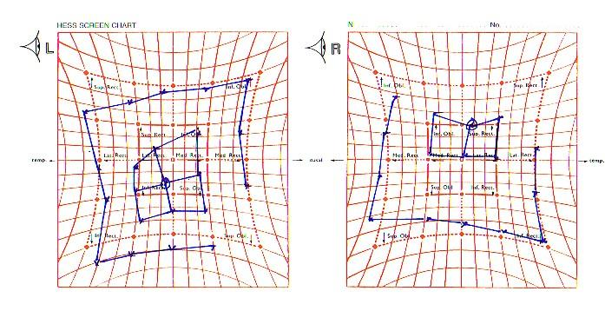
o/a RIO
u/a LSR
u/a RSO
o/a LIR
Left Superior Rectus palsy (longstanding)

Slide 10
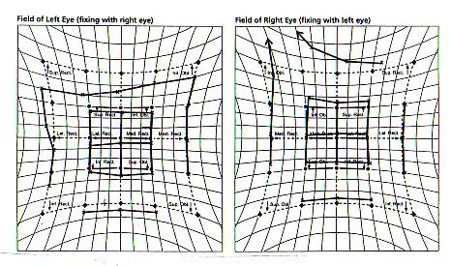
o/a RIO
u/a LSR
Left Superior Rectus palsy (recent onset)

Slide 11
Longstanding vs Recent Onset
The primary & secondary deviations are approximately equal in size | The secondary deviation will be significantly larger than the primary
Muscle sequelae may well be fully developed | Over-action of the contralateral synergist will be evident but the other muscle sequelae will not have developed

Slide 12
Quick Guide to Cranial Nerve Palsies - VICNP
Most common isolated cranial nerve palsy
Path of the sixth nerve travels close to the cavernous sinus, the ear & the skull
Long, thin nerve (second longest course) –can be damaged by anything that stretches it, or compresses it.
Therefore – multiple possible causes; ischaemic neuropathy (diabetes, hypertension) raised ICP (idiopathic or due to a space occupying lesions), demyelinating disease,
Typical presentation: Eso, increasing with distance of fixation Restricted abduction of one eye Head turn to affected side May take well to prismatic correction

Slide 13
Quick Guide to Cranial Nerve Palsies - IVCNP
Less common isolated cranial nerve palsy – most common in children
Path of the fourth nerve distinctive by emerging form the back of the brainstem & crossing over. This makes it vulnerable in head trauma – especially contre coup injuries
Longest course of the cranial nerves
Most common causes in adults are hypertension & trauma. However, as with the sixth nerve, can also be damaged by anything that causes compression, as well as vascular cause.
Typical presentation: Vertical deviation & vertical diplopia (possibly with one image tilted Head tilt to unaffected (less) affected side, & chin depression Problematic diplopia – worse for near & even worse when looking down i.e. reading position May not tolerate/fully benefit from prismatic correction May be bilateral but asymmetrical
Notes:
Contre coup – quick decelaration of the head. Tilt to lower eye

Slide 14
Quick Guide to Cranial Nerve Palsies – IIICNP
Least common
Supplies multiple structures: Superior division; Upper eyelid, superior rectus Inferior division; Medial & Inferior rectus, pupil & ciliary muscle
The outer fibres supply the ciliary muscles and the sphincter pupillae. The inner fibres supply the motor nerves
Most common causes in adults are diabetes & hypertension, & trauma. Compressive lesions such as PCA aneurysm or SOLs are less common
Typical presentation: Eye ‘down & out’ Ptosis of affected eye Dilated pupil on affected side (red flag) Little hope of joining diplopia (although lid may act as an occluder)
Notes:
Compressive lesion – affects all fibres i.e. pupil. Common cause vascular ischaemia affecting blood supply

Slide 15
Non cranial nerve causes of diplopia
Decompensating phorias
Convergence/accommodation defects
Thyroid Eye Disease
Trauma – resulting in mechanical restrictions eg orbital trauma
Myasthenia Gravis
Change in childhood strabismus
Notes:
Decomp – interrupted fusion – any eye disease, intoxication, meds
Trauma – fist, just the right size

Slide 16
MCQ
Q. What sort of trauma is most likely to result in an orbital wall fracture, & subsequent muscle entrapment
A Squash ball
B Fist fight
C Contre coup

Slide 17
Red Flags
Multiple cranial nerve involvement
Restriction of eye movement with dilated pupil in same eye ( esp with ptosis)
Pain
New ptosis with any eye movement problem (NB watch out for pseudoptosis with a vertical deviation)
Problem getting worse
Associated with general acute malaise
Swallowing difficulties
NB Size of deviation & suddenness of onset do not necessarily correlate with the most sinister cause
Notes:
Not necessarily ptosis – so common in older patients
Size suddenness – not necessarily most sinister, Eg sudden onset VICNP – hypertension – recovers on 3-6 months
Pain – may be a sign of compressive lesion/lack of blood supply

Slide 18
MCQ
Q. A recent onset ‘pupil sparing’ third nerve palsy should be referred
A Urgently
B For ‘soon’ attention
C Routinely

Slide 19
MCQ
Q. Least ‘red flag’ bilateral cranial nerve palsy
A Third
B Fourth
C Sixth

Slide 20
Good referrals – info to include
Duration
Onset – sudden or gradual
Incidental finding or main cause of visit
Eye movement findings (plus differential diagnosis if you can)
Documenting absence of signs just as valuable as their presence eg ºhead posture, ºpupil involvement, ⁰pain
Known general health risk factors (or not)

Slide 21
Community Management of Diplopia
To prism or not to prism???
Flag any worsening/new signs
Contact the Orthoptic Department directly if you need info
01902 695830
rwh-tr.OrthopticAppointments@nhs.net
Notes:
No advice & guidance but we’re happy to receive queries

Slide 22
Community Management of Diplopia
To prism or not to prism??? - incorporation
Beware correcting with large amounts
Beware combinations of vertical & horizontal
Beware tenuous correction of diplopia/non-tolerance of Fresnel
Beware torsion
Beware head postures
Beware early correction
Beware patient’s expectations
Notes:
No advice & guidance but we’re happy to receive queries

Slide 23
Community Management of Diplopia
To prism or not to prism???
Small amounts
Longstanding, stable deviation/diplopia
If you’re going to refer – generally hold off giving/changing prism

Slide 24
MCQ
Q. The primary reason that diplopia in a IVCNP may be tricky to join due to:
A Combination of vertical & horizontal components of devn
B Presence of torsion
C It changes in different positions of gaze

Slide 25
Contact the Orthoptic Department :
01902 695830
rwh-tr.OrthopticAppointments@nhs.net
Notes:
No advice & guidance but we’re happy to receive queries

Slide 26
MCQ
Q. Most common cause of acquired sixth nerve palsy
A Trauma
B Tumour
C Vascular

Slide 27
MCQ
Q. Cranial nerve palsy most likely to be associated with unilateral hearing loss
A Third
B Fourth
C Sixth

Slide 28
MCQ
Q. Which of these is suggestive of a neurogenic defect
A Duction = Version
B Duction > Version
C Version > Duction

Slide 29
MCQ
Q. A sixth nerve palsy will always result in an
A Esotropia
B Exotropia
C Neither of above

Slide 30
Questions????
Notes:
No advice & guidance but we’re happy to receive queries

