Slide 1
Eyecare e-Referral Service
Overview
Helen Beasley
EeRS Project Manager

Slide 2
Background
Eyecare Electronic Referral Service(EeRS)has been rolled out across Greater Manchester, Cheshire & Merseyside and Lancashire & South Cumbria to support patient care and improve access to targeted eyecare.
This has been implemented to transform how services are delivered in the future by:
• Enabling primary eye care clinicians in optical practices to send electronic referrals
• Supporting secondary care services to manage referrals and patient care more efficiently
• Facilitating the sharing of images and clinical findings
• Developing and strengthening shared care pathways across primary, community and secondary eye care services
• Removal of the use of faxes, streamlining the referral process to hospitals and enabling greater patient choice

Slide 3
Roll-out Update
The service went live in May 2022
This means the service is already up and running at all our hospital sites and they are actively receiving and processing e-Referrals
In addition, we have 164 Optical practices already onboarded on to OPERA and actively using the system to process GOS18 referrals
To date 513 referrals have been processed and of those 50 had images attached
We are currently working alongside all Trusts to enable referring practitioners the ability to receive feedback letters
Advice & Guidance is shortly being piloted in Cheshire and Merseyside

Slide 4
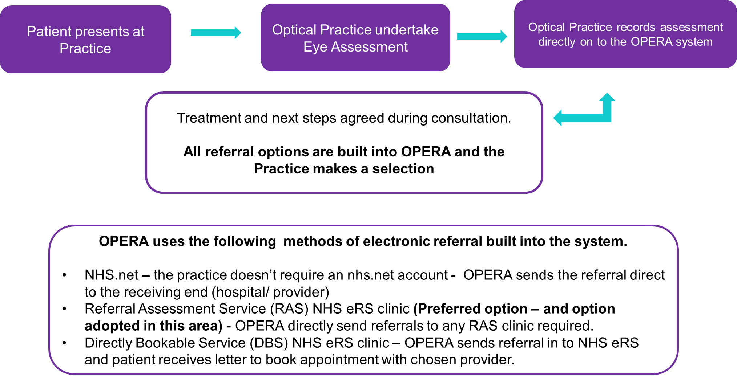
How the Service/Process Works

Slide 5
Benefits
Allows your referring clinician to send images to the specialist to help with your diagnosis and treatment
Reduces time taken to complete a referral, releasing time for patient care
Rapid transfer of your referral electronically reduces delays in the hospital receiving your referral
The system has tracking features so the status of your referral can be easily seen
Designed by clinicians around the patient pathway to ensure it gives the best patient outcomes
Improved user experience, easy and clear to use and with access from multiple locations
Reduces number of referrals into secondary care (e.g. Advice & Guidance)
Data collected for improved audit and training
Improved data and information sharing

Slide 6
Case Study
Previous
84 year old male attended complaining of vision being affected - delay in seeking treatment due to patient believing it was cataracts due to their age
An urgent referral was made however, this was via letter/post and it took 10 days before patient was written to offering an appointment at St Paul’s
The patient was diagnosed with ocular melanoma, had successful treatment at Clatterbridge and is now under 6 month reviews at St Paul’s
The referring optician hasn’t yet received feedback

Slide 7
Case Study
Now
73 year old lady had proton beam therapy for a malignant melanoma 5 yrs ago under annual (September) review by St. Pauls. Attended for eye exam complaining the eye “felt different”
Examination revealed haemorrhages & exudates over the retina scar tissue. Unsure whether this was related to the original problem or a coincidental branch vein occlusion. An urgent eGOS18 with an image attached was submitted.
Within 1hr St Pauls had reviewed and booked patient into a clinic giving both optician/patient reassurance that problem had been dealt with.

Slide 8
How to Engage in the Services
To support Optical practices to engage in this new service a dedicated Online training tool has been developed which supports users to:
Understand more about the service
How to onboard onto OPERA
How to process a referral
How to track a referral
Opportunity to run a test referral
How to view images within referrals
How to provide feedback on referrals
Information on where to find additional help and support
And much much more!.....
https://e-referral.education/

Slide 9
Contact Details
Help & Support
LOC Support: Adam Ornrod - locliverpool1@gmail.com
PES Local Clinical Lead:
Timothy Bagot– Timothy.Bagot@primaryeyecare.co.uk
EeRS Project Manager:
Helen Beasley - Helen.Beasley@cheshireandmerseyside.nhs.uk
OPERA support:
OPERA Help bubble on home page or hello@referral.support
OPERA Website support pages available: https://help.optom-referrals.org/
Online training/ support tool: https://e-referral.education/

Slide 10
Thank You

