Slide 1

EYE CASUALTY REFERRALS
SERVICE GOES LIVE ON THE 22TH JANUARY 2025
OPTICAL PRACTICE INFORMATION PACK
PART ONE

Slide 2
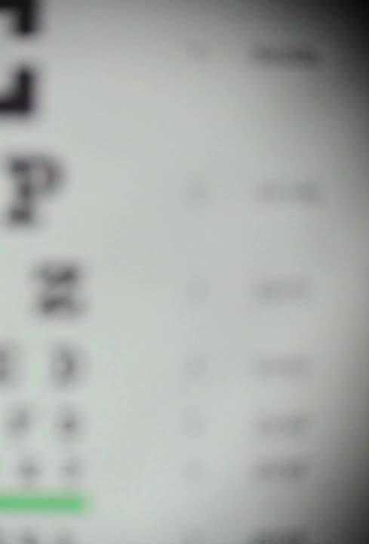
EYE CASUALTY PILOT – REFERRALS FROM OPTICAL PRACTICES ONLY
To Test an Electronic Eye Casualty Pathway – starting January 2025 final date to be confirmed
The Eye Casualty Referral Form: Will be added to the suite of Cinapsis referral templates prior to going live
Optical Practices to electronically refer to Eye Casualty using the Eye Casualty Referral Template (only) – 3 clinical priorities using Cinapsis:
  True Ophthalmic Emergency – to be seen same day
  Suspected Emergency Conditions – to be seen within 24hrs
  Ophthalmic Emergency – to be seen within 7 days
Eye Casualty Team will accept and process the referral – Eye Casualty clinicians will clinically prioritise referrals.

Slide 3
List of True Ophthalmic Emergencies – to be seen same day
Angle closure: red and painful with raised IOP
Acute third nerve palsy: record if there is pupil involvement or pain
Central retinal artery occlusion: within 12 hours of onset
Central retinal vein occlusion: with pain or raised IOP
Chemical eye injury: recent only – irrigate copiously before sending
Corneal graft rejection
Endophthalmitis: following Cataract or intraocular surgery
Giant cell arteritis / temporal arteritis with visual disturbance only (e.g. Blurred vision): if no visual disturbance, please refer to general A&E at a local hospital
Hypopyon: pus in anterior chamber
Iris prolapse: cover with an eye shield if available
Orbital cellulitis
Painful eye: no known cause with nausea/vomiting
Painful eye in postoperative intraocular surgery: <2 months post-op
Proliferative diabetic retinopathy with severe pain or raised IOP
Raised IOP: >35mmHg
Retinal detachment: Acute (i.e. recent symptoms), fovea (macula) attached
Scleritis – necrotising acute anterior or posterior: pain causing patient to wake up from sleep
Sudden unexplained severe vision loss: within 12 hours of onset, record if associated with pain or without (painless)
Trauma – corneal laceration
Trauma – intraocular foreign body: excluding superficial corneal foreign body
Trauma – globe perforation

Slide 4
List of Suspected Emergency Conditions – to be seen within 24 hours
Arc eye
Blunt trauma / commotion retinae
Central retinal artery occlusion: 12 hours & over from onset
Contact lens related problem: e.g. corneal ulcer, infected keratitis
Corneal abrasion (severe)
Corneal or subtarsal foreign body
Corneal ulcer/melt or painful corneal opacity
Dacryocystitis (acute)
Diplopia / squint / ptosis / nerve palsy: acute onset within 4 weeks
Disc swelling / papilloedema with symptoms: e.g. headache & vision loss
Floaters / Flashes: <48hrs from onset with positive Shafer’s sign / tobacco dust
Horners syndrome: with pain
Hyphaema
Lid laceration
Optic neuritis: new presentation only, known cases refer in 7 days
Orbital fracture if blurred vision or double vision: if no visual disturbance, please refer to general A&E at a local hospital
Proptosis: onset within 1 week
Sudden severe ocular pain or pain on ocular movements
Retinal detachment: Acute, fovea detached within preceding 5 days (macula off) or tear
Retinal Tears: Acute U-tear/s, no RD, symptoms up to 48hrs
Vitreous Haemorrhage: recent onset, unexplained vitreous haemorrhage within last 48hrs
Uveitis

Slide 5
List of Ophthalmic emergency – to be seen within 7 days
Anisocoria: with symptoms of pain, headache or vision loss
Bells palsy: if new onset, suggest medical team first to rule out stroke (ask GP to refer)
Central serous retinopathy
Conjunctivitis (atopic) with corneal involvement
Conjunctivitis (severe microbial): if not responding to topical antibiotics
Conjunctivitis (vernal) with limbal or corneal involvement
Conjunctivitis (viral) with pseudo membrane
Corneal abrasion: unresolved
Corneal hydrops
Dacryoadenitis: acute
Distortion: with unknown cause
Episcleritis: if worsening and suggestive of scleritis
Herpes Zoster Ophthalmicus: if suspected shingles with no eye involvement, refer to GP
Marginal keratitis
Myopic CNV
New pupil defect
Optic disc swelling with no symptoms
Optic neuritis (if known): if new presentation, please refer within 24hrs
Painful entropion
Pre septal cellulitis / infected chalazion
Proliferative diabetic retinopathy: new onset, without pain (includes vitreous haemorrhages for known PDR patients)
Proptosis / exophthalmos (chronic)
Rubeosis iridis
Scleritis: if necrotising anterior scleritis or posterior scleritis, refer immediately
Sudden / recent onset of distortion of vision: (excluding Wet AMD)
Suspected cancer
Severe infective conjunctivitis: if not responding to topical antibiotics
Vein occlusion: only with signs of neovascularisation/rubeosis or a central haemorrhage
Retinal Detachment:
  Definite chronic, fovea attached
  Acute, fovea detached for 7 days or more
Retinal Tears: Acute U-tears/s, no RD, symptoms over 48hrs
Vitreous haemorrhage: recent onset, unexplained vitreous haemorrhage more than 48hrs previously

Slide 6
All Other Conditions (Not an Emergency Referral)
If the clinical condition of the patient is not listed in the previous categories, it is likely that the patient has a non-urgent case that needs a routine/urgent referral. Please exit this form and refer via the appropriate routine / urgent pathway.
Examples of non-urgent cases are as follows:
Allergic conjunctivitis: See GP / Pharmacist for drops if required
Mild to moderate conjunctivitis: See GP / Pharmacist for drops if required
Blepharitis/Chalazion: See GP / Pharmacist for drops if required
Raised IOP with no pain or visual disturbance: refer via the EACH for assessment in COTATs
Dry eyes / Watery eyes
Ectropion
Macular Hole: all types; epiretinal membrane, NOT Urgent, routine referral to vitreoretinal services within the patient’s locality
Dislocated lens implants
Known proliferative diabetic retinopathy: defer to MR guidance
Squint – gradual onset / long-standing
Cataract / posterior capsule opacification
Sudden loss of vision: Onset >12 hours
OPTICAL PRACTICES STILL HAVE THE OPTION TO CONTACT EYE CASUALTY FOR ADVICE AND GUIDANCE BEFORE MAKING A REFERRAL

Slide 7
ACTIONS / REFERRAL PROCESS FOR EYE CASUALTY
EYE CASUALTY CORE HOURS 0900 – 1630 MON – FRI: All referrals via Cinapsis, no phone call needed. On call is available for advice if needed.
EYE CASUALTY ON-CALL 1630 – 1700 MON – THURS: TRUE Emergency Referrals – phone Eye Casualty at the hospital of choice (Lincoln or Boston), following this phone call complete the referral form on Cinapsis noting details of discussion and advice given. Other emergency referrals via Cinapsis, no phone call required.
  Lincoln: 01522 572292
  Boston: 01205 446619
  Please note FRI 1630 – 1700: phone HES for True Ophthalmic Emergency (same day) AND Suspected Emergency Condition (24hr) referrals

Slide 8
ACTIONS / REFERRAL PROCESS FOR OUT OF HOURS
(Call 01522 512512)
OUT OF HOURS: 1700 – 0900 MON TO THURS:
  True Ophthalmic Emergency – call Out of Hours via switchboard, following this complete referral form on Cinapsis noting details of discussion and advice given
  All other referrals via Cinapsis
OUT OF HOURS: FRI 1700 – MON 0900
  True Ophthalmic Emergency and Suspected Emergency Condition (24hr) emergency referrals – call Out of Hours via Switchboard – following this complete referral form on Cinapsis noting details of discussion and advice given
  All other referrals via Cinapsis

Slide 9
OPTICAL PRACTICES – USEFUL INFORMATION
Once Live Eye Casualty will accept referrals from Cinapsis and via telephone for the first month.
From month 2 referrals will ONLY be accepted using the Cinapsis Eye Casualty Referral Form. Any other form will be rejected (including GOS18)
Should Cinapsis not be available (internet is down) please revert to contacting Eye Casualty by telephone.

Slide 10
OPTICAL PRACTICE PATIENT COMMUNICATION
Some suggested guidance on information to give patients: When making an Eye Casualty Referral the following narrative can be used
Having reviewed your eye sight it is my recommendation to refer you to Eye Casualty. I will do this today electronically. Please ensure that the contact details provide are correct and the most appropriate telephone / mobile number for contact
True Ophthalmic Emergency (Same day): Eye Casualty will review your referral and will contact you directly by close of play today to arrange an appointment. Please ensure you are available to attend
Suspected Emergency Condition (24hrs): Eye Casualty will review your referral and will contact you directly within the next 24/48 hours
Ophthalmic Emergency (7 days): Eye Casualty will review your referral and will contact you directly within the next 7 days

