Slide 1
NHS England and Improvement Midlands Region
EeRS – Midlands Deployment
2023
dominic@cinapsis.org
www.cinapsis.org

Slide 2
Objectives
Cinapsis – Brief Overview of the team
What is EeRS
Expected Benefits
Proposed delivery approach
Q&A

Slide 3
Brief Introduction to Cinapsis
Relevant Senior Contacts
Dr Owain Rhys Hughes
CEO
William Lee
CTO
Dominic Markham
Head of Delivery
Anca Leucon
Training and Support Lead
Mick Vought
Product Manager
Rahman Malik
UX Design Lead
Bruce Richards
Head of Engineering
Mike McSweeney
Information Governance Lead
Georgia Kingston
Head of Marketing
Carl Woodroffe
Business Development Manager
Recent Project Delivery Success Examples
Bath, Swindon & Wiltshire ICS
- Multiple Services
120 Services (planned & urgent care)
Handling urgent & planned care from Ambulatory Care, MoD, GP’s, Community Providers
2422 Users
Called out as Exemplar deployment by ICS
Live within 3 months from commencement, replacing incumbent provider with no operational disruption
Ongoing transformation programme
Positive user feedback
Cambridgeshire & Peterborough ICS
- EeRS
Deployed successfully on time as one of the first EeRS providers to market
Demonstratable continued improvement to tailor and develop the solution in response to customer feedback
Cinapsis were a member of the Alpha team, working in partnership with NHSE and a small working group to define the PMS API specification
Positive feedback from SP’s & Optoms
Cheshire & Merseyside ICS
- Teledermatology
Fully live in Liverpool, with active roll outs in Cheshire and Merseyside
Supporting a reduction in avoidable demand by up to 50%
Demonstratable evidence of continued improvement
Positive user feedback in Acute and Primary Care
Building Better HealthCare Award Finalist 2022
Interfacing
EPS/PAS
(FHiR/HL7)
PDS
NHS App
eRS
NHSE EeRS API
EMIS
Systmone
Systmone Community
NHS DLP
MESH
…

Slide 4
What is an Electronic Eyecare Referral System (EeRS)?
Put simply:
EeRS systems help bring Ophthalmology into the digital age, removing paper based or unsecure processes from the patient journey and empowering experts in eyecare to better manage patient care
Cinapsis’ EeRS system can support both referrals and advise and guidance, helping clinicians better communicate, learn and to deliver the best patient outcomes.
Lets have a look at a recent BBC Look East clip (under 4 mins):
To see a demo of Cinapsis, register here:
Live TV
Cinapsis Demo

Slide 5
Indicative Cinapsis EeRS Referral Process with eRS interface
Patient
Optical Practice
(Referrer)
GP Practice
SP
Secretarial Team
SP Ophthalmologist
SP
Booking Team
Patient visits clinician & presents symptoms
As per current process
*Note – Can be done as a batch task
Select destination for outcome, complete referral / A&G form request & attach images on Cinapsis
Visit to
GP
Triage case & select Outcome on Cinapsis
Booking team logs in with Smartcard and releases referrals from Cinapsis to eRS*
Cinapsis Case
eRS
Optical Practice
&
GP received copy of outcome letter (if GP details available)
Uploaded to patient encounter
Patient booking completed by booking team***
Emailed (if details provided to Cinapsis) – new MESH enabled integration will capture all GP’s
Outcome letter emailed**
Outcome letter sent into Cinapsis inbox & nominated practice nhs.net account
Referral required
UBRN added to Outcome letter
&
N
Y
***Note – For referrals, start date will need adjusting to case start date until NHSE deliver enhanced API
Outcome sent as Cinapsis Case / Alert & email
Patient informed
**Note – action by secretary may not be required if booking team update encounter. Process can be automated via EPR/PAS integration if required(not procured)
Patient informed
Action taken

Slide 6
Expected Benefits
Fully electronic flow (reduced IG & clinical risk)
Multi directional flows
Education
(e.g. signposting, A&G)
Enable better use of community resources
Free up GP time
Local DOS - support right first time data sets
Reduce/Eliminate avoidable referrals
Improved QoL outcomes
Reduce patient delays
Send valuable clinical Imaging e.g. Full volumetric OCT
Improved visibility for Referrer & SPs
User friendly platform, saving clinicians time
Etc…
High quality data/insight (support strategic decision making across ICS & SP Orgs)

Slide 7
Proposed Delivery Approach

Slide 8
Proposed Approach to Delivery (Prince 2)
Control gates
*Flexibility in the phase this is triggered in
Pre-Implementation
Design
Delivery
Transition
COMMERCIAL AGREEMENT & INITIATION
PLANNING & DESIGN
IMPLEMENTATION
TESTING
TRAINING
GO LIVE
Contractual agreement and approval
Cinapsis and Authority appoint Programme Manager & Sponsor
Identify in scope ICS’
Indicative ToR & Plan agreed
Risk Management approach agreed
Trigger recruitment of additional Project, Training and Implementation resources
Agreement to proceed to Design
Identify & engage core project team
Identify referrer organisations/contacts - initiate early phase comms
Demo session(s) with core stakeholders e.g. Service Providers, LOC, Community Providers, GPs, etc.
Outline service design (inc. DOS structure) and integration requirements captured based on agreed scope
Submit any development needs
Refine & approve detailed ToR & Plan
Agreement to proceed to Delivery
DPIA approved and DPAs signed by SP’s & Optom Practices participating in project testing
CSO review/approval
Build to specification, with iterative workshops to refine SP requirements
Functional requirements approved
Reporting requirements approved
Interfacing requirements approved
*Registration of Interest communications distributed
Agreement to proceed to Testing
Iterative feedback and refinement to EeRS solution based on user feedback
UAT/Functional Testing completed & approved
Live environment ready
Cinapsis Project to Support Handover
Agreement to proceed to Training
Optometrist webinar events / online learning
SP training Webinars (Admin/Clinical)
ICS Training on Cinapsis ICS Dashboards
Training collateral shared /Knowledge Base access
Bespoke onsite training (if required)
Technical/ Operational Readiness Sign Off
Launch Comms issued
Agreement to Go Live
Participating organisations enabled for live use
ICS & Operational Acute Service staff monitor utilisation via Cinapsis Dashboard
Collaborative work to drive uptake/registration
Cinapsis Support engaged to assist users with Issues, or additional training needs
Continual Review & Improvement
Agreement to proceed to next delivery

Slide 9
Summary of Activity
EeRS Set-up Process (Design – Deliver)
Cinapsis/ICS PM - Identify Trust Resources & on-board to NHSEM EeRS Project Team
Cinapsis - Webinar for Trust/ICS Project Teams
ICS IG Lead /Cinapsis- Complete DPIA & Data Sharing Agreement
ICS CSO - Complete Clinical safety Case Report
SP IT - whitelist app.cinapsis.org & check firewalls are open, deploy Toolbar to booking team members for eRS Integration activity
Cinapsis - Set-up Development, Test & Production environments
Create EeRS Service (Deliver – Transition)
Create EeRS Service (Deliver – Transition)
Primary Care – Optical Practice Providers (OPP), Community Providers
Secondary Care – Ophthalmologists
ICS - Identify Clinical, Service, IT, BI and booking lead for each SP
Cinapsis - Webinar to demo EeRS platform & how to configure the service
SP - Complete ‘Service On-boarding’ form
Cinapsis – Workshops to refine service with Clinical & Service Leads
Cinapsis – Add Lead users
SP – Add remaining clinical/admin users
Cinapsis/SP/LOC - Peer Groups feedback – Cinapsis update/log changes
Cinapsis - Training webinar delivered to Clinician & Admin Users
All - Service go-live supported by User Comms
ICS – Update onboarding tracker with basic referrer details
LOC/ICS – Engagement Comms
Cinapsis - Webinar with Practice Mgrs to demonstrate EeRS platform
Practice - Register interest with Cinapsis and return signed DPA
Cinapsis – Add lead Practice Admin and arrange training
Cinapsis - Training delivered to Optometrists (Group Webinars and/or on demand modularised training)
All - Service go-live supported by User Comms
EeRS System Integration
Key:
Cinapsis - Engage Trusts & Practices to identify IT/EPR Systems
Cinapsis/SP PM/IT - Prepare e-RS integration processes
Cinapsis/SP PM/IT - Carry out e-RS system integration
Cinapsis/SP PM/IT - Carry out PAS/EPR integration roll-out
Cinapsis - Facilitate activation for Optom PMS integration (availability dependent on PMS supplier build status)
SP = Service Provider

Slide 10
How can I get my Optometry Practice ready?
The process will be quite simple when you join and more information will be shared by the project team.
To help ready your practice, two key activities will be to:
1) Ensuring your practice is DSPT compliant
Optom Practices can use the Quality in Optometry website to walk through the accreditation and submission process. This is recommended as the journey and required steps are clearly laid out as a walk through. Link: Quality in Optometry – Login
Alternatively, further information is available here (you can also submit your DSPT registration directly through the DSPT portal if preferred): https://www.dsptoolkit.nhs.uk/Help
2) Identifying a stakeholder in your organisation to approve a Data Processing Agreement
The project team will share the Data Processing agreement with you when Cinapsis is commissioned into your area

Slide 11
Proposed Roll Out Plan

Slide 12
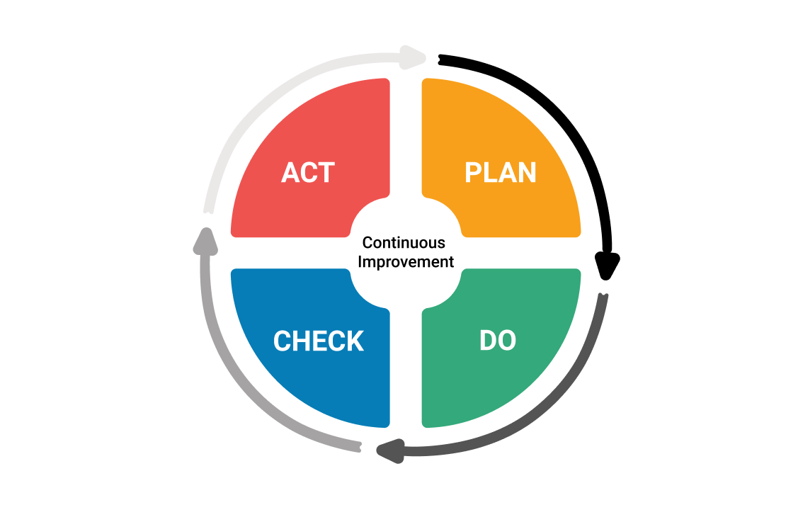
High level plan based on tender requirements from NHSE England and Improvement Midlands Region tender (contract signed end Feb ‘23)
Initiation start date dependent on ICS readiness to start and commercial approval (below dates are estimates
Roll out can be expedited if required
Proposed Roll out Plan
Start
Mid Mar 23
Pilot
Full Roll Out
Pilot 1
Live July ‘23
Pilot 2
Live Aug ‘23
Phase 1-3 Go/No-Go
Sept ‘23
Phase 1
Live Jan ’23
Phase 2
Live Feb ‘24
Phase 3
Live March ‘24
Pre-implementation
Pre-Transition Activity
Planning & Design
Phase 2 Review & Assess Pilot
Implementation
Pre-Transition Activity
Phase 1 (3XICS)
Transition
Testing
Training
Pilot 1 ICS
Transition
Pre-Transition Activity
Phase 2 (3XICS)
Transition
Pre-Transition Activity
Pilot 2 ICS
Transition
Pre-Transition Activity
Phase 3 (3XICS)
Transition

Slide 13
Lessons Learnt from EeRS Deployments
Resource - Lessons
Project resources - should be assigned by each ICS to support the programme roll out
Clinical and Operational leads within each SP will be required, as well as booking team representation to support testing and configuration of eRS integration and end to end workflow
A senior sponsor per Service Provider is also advised, to act as a change ambassador
SP job planning – Operational and clinician leads should consider job planning to ensure pathways are resourced
SP ICT and Integration resource is in high demand, presenting a risk for EPR integration. We recommend provisional discussions are undertaken with Service Providers IT leadership to identify any risks and ensure the required teams are made available to support interoperability deployment, testing and go live
SP project management/change teams – If relevant, activity should be mapped in for them to support technology roll out in line with normal processes
Commissioning/Service Ownership – To truly realise benefits, SP’s and commissioners should appoint ownership to monitoring performance once in BAU
Managing Change - Lessons
Current ways of working – There is often a lack of understanding in ICBs/SPs of current state - mapping this is vital to successful change. Recommendation work is undertaken by each area Service Provider to document current ways of working. This will significantly facilitate any project rollout, as well as reducing risks.
Communication - Service Provider and LOC engagement with Optoms to encourage uptake is vital, as is considering the closure of dual working e.g. continuing to maintain email A&G, when user should be encouraged to use the new EeRS service
Advice & Guidance - hugely value by Optoms and to improve patient care – if not in place, this should be considered to encourage uptake & help deliver demand elimination
Who are the Optoms
No single complete data source - NHSE data can be out of date and LOC data does not always contain a full list of all sites, especially those referring from nearby borders. Relevant contact data within Optom Practices is also an issue. We recommend the ICBs undertake a joint exercise with NHSE, SP’s and the LOC to amalgamate and cleanse the data source and contacts of referrers
Technical
RTT – A technical limitation of the eRS API means only the UBRN creation date, rather than the case creation date is recorded in eRS. This works well when converting A&G to a referral, but SP’s may need to include a manual adjustment of the start date for referrals (to align to the date a case was created – data is on the pdf sent via the API and in supplier data). If the SP workflow auto-converts cases from eRS to their ePR, this action normally involves using the function in eRS to “book outside of eRS” (then enter manually into the ePR) or the SP opening up the permission for a group of users to adjust the start date once in the EPR. SP’s normally undertake similar workarounds due to multiple processes into the Trust e.g. email referrals, Dentistry referrals, other A&G systems which are used for referrals (e.g. dentistry, etc)

Slide 14
Any Questions?

Slide 15
END
Thank you

