Slide 1
EeRS Optical Practice Onboarding Step by Step Guide

Slide 2
Data Protection Agreement/Protocol (DPA/DPP)
0. Multiples – Skip this step if your HQ completed the DPP/DPA. Cinapsis will be in touch if this is not the case.
All other practices:
Access your Data Protection Protocol/Agreement document
Review the document and obtain a digital signature from your Caldicott Guardian or Practice Manager
Save a copy of the signed version to your computer
Please note: You will be asked to upload this document as part of the onboarding process (see step 21/slide 12).

Slide 3
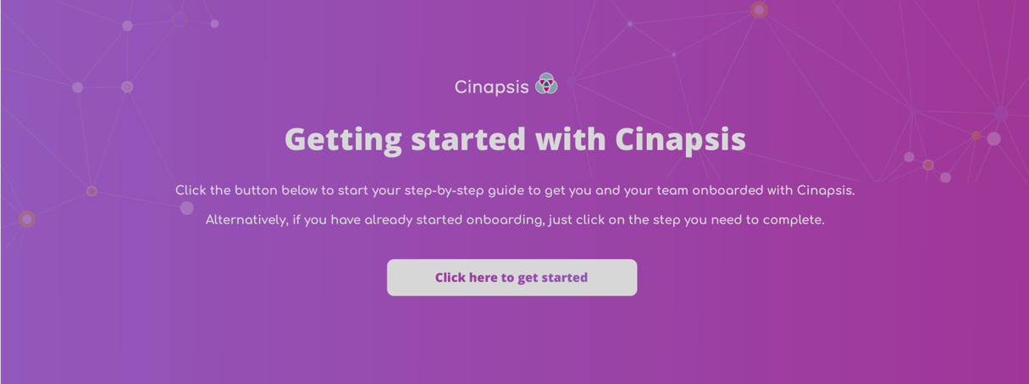
Cinapsis Registration of Interest Form
1. Click the Registration of interest link
The Cinapsis web browser PDF opens
2. Click – Click here to get started

Slide 4
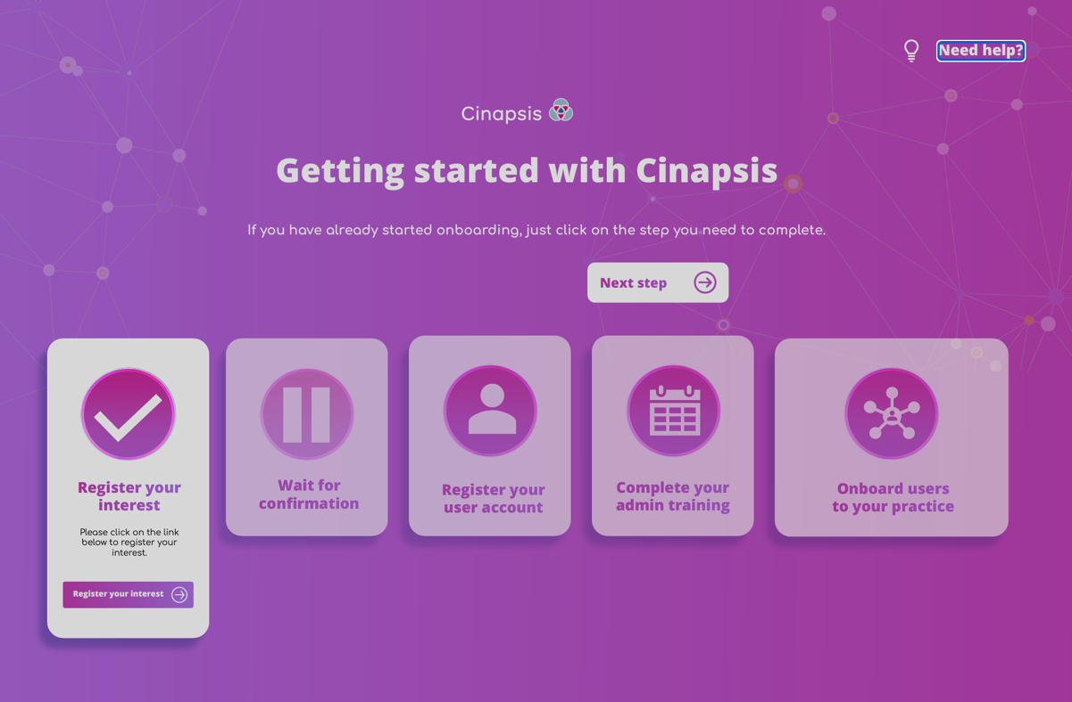
Onboarding Dashboard
3. Your stage in the onboarding process is shown
For help, click the Need Help? icon in the top right corner to contact Cinapsis
4. Click Register your Interest to open the practice setup form
5. On the acknowledgement screen click Start

Slide 5
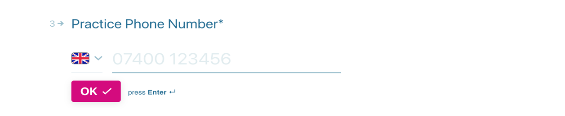
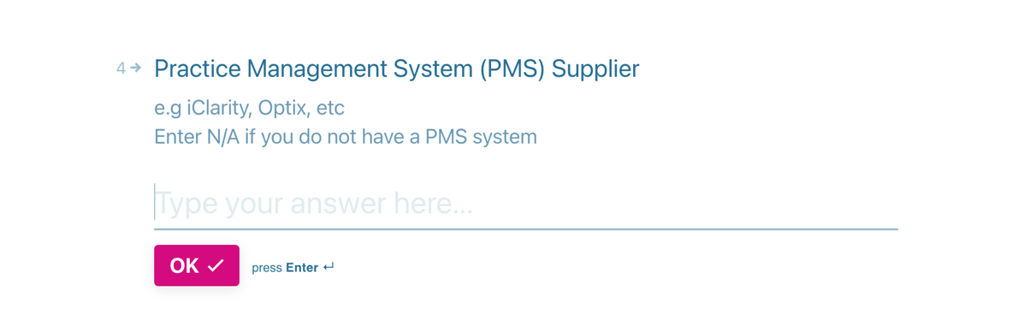
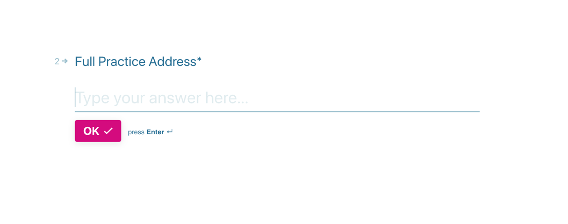
Practice Details (Q1-4)
6. Type your Practice Name (this will help providers identify your practice), click OK
7. Type the practice’s full address, click OK
8. Type the practice’s telephone number, click OK
9. Add details of your Patient Management System (this is to support integration), click OK

Slide 6
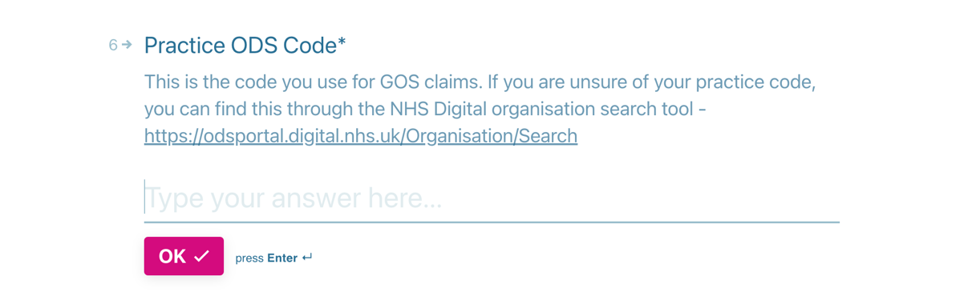
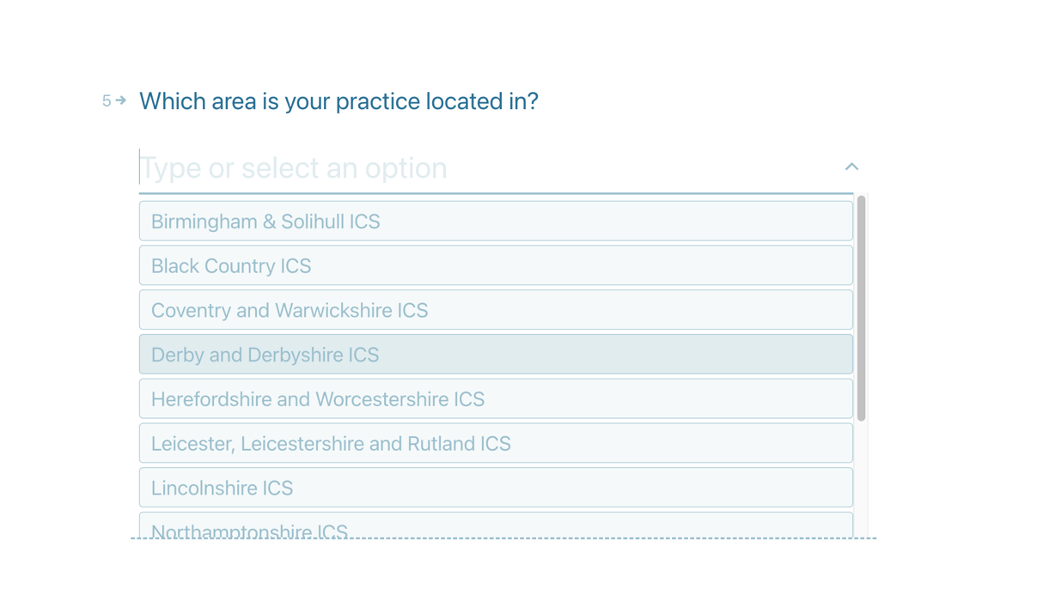
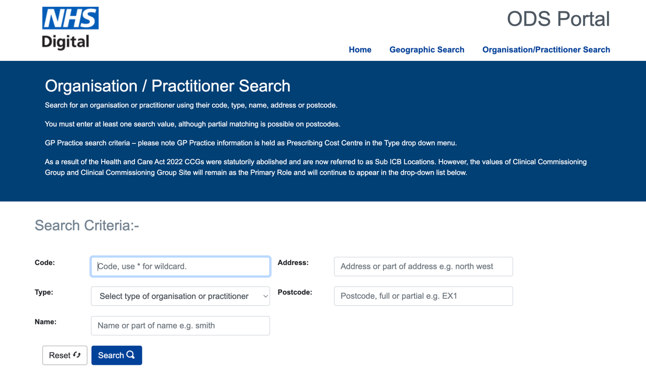
Practice Details – continued (Q5+6)
11. Add your ODS Code, click OK
Your ODS code can be found here:
https://odsportal.digital.nhs.uk/Organisation/Search
10. Select Coventry and Warwickshire ICB from dropdown, click OK

Slide 7
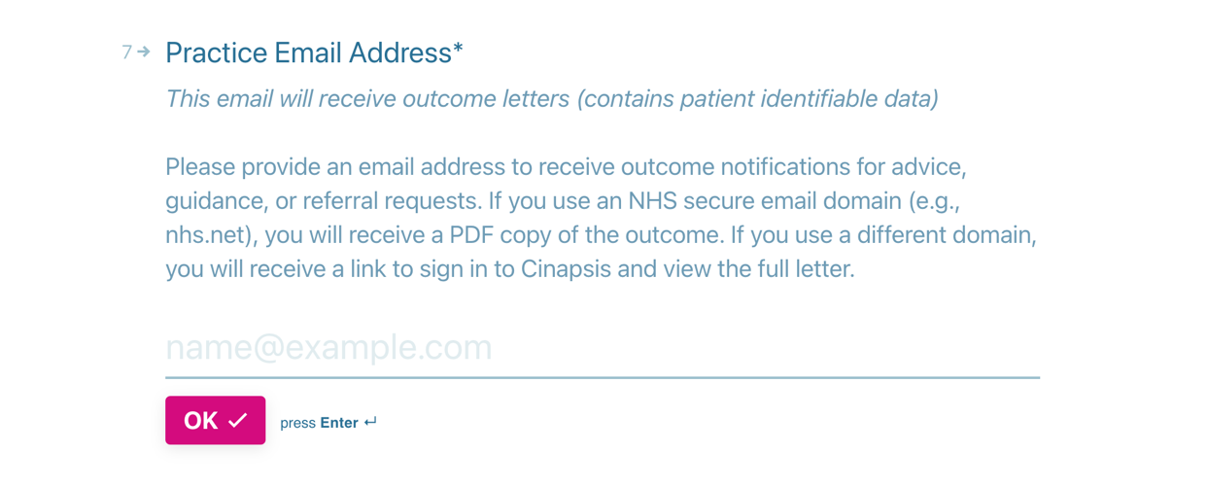
Practice Email Address (Q7)
12. Add a generic/shared practice email address here, click OK
This email will be used to send referral responses for ALL referrals, therefore avoid using personal email addresses. If possible, use your shared NHS.net account to allow for PDF copies to be sent. If you do not have an NHS.net generic account, use any other shared mailbox, a link will be sent asking users to log into Cinapsis to access responses.

Slide 8
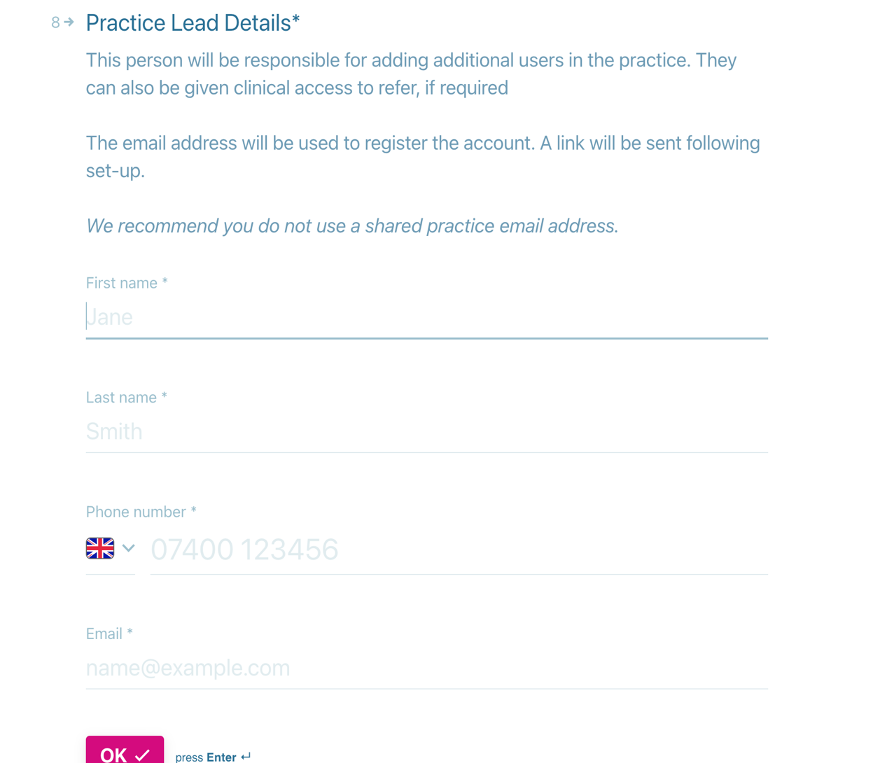
Practice Lead Details (Q8) for personal user access
13. Type Your First Name,
14. Type Your Surname,
15. Type Your Telephone number,
Use your personal number as this will be used as an authenticator and for password resets.
16. Type Your Email address
Use your personal work email as this will be used as your login. Avoid using shared access emails. Ideally NHS.net where possible.
click OK

Slide 9
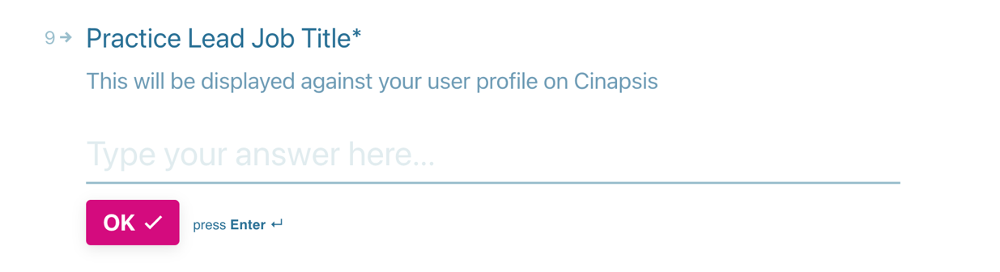
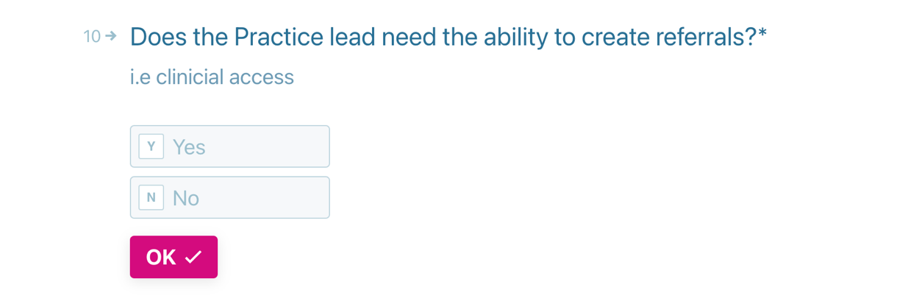
Practice Lead Details – continued (Q9+10)
17. Type Your Job Description, click OK.
18. Confirm whether ‘you’ need access to send referrals, click OK.
Yes will give both admin and clinical access, No will only give admin access

Slide 10
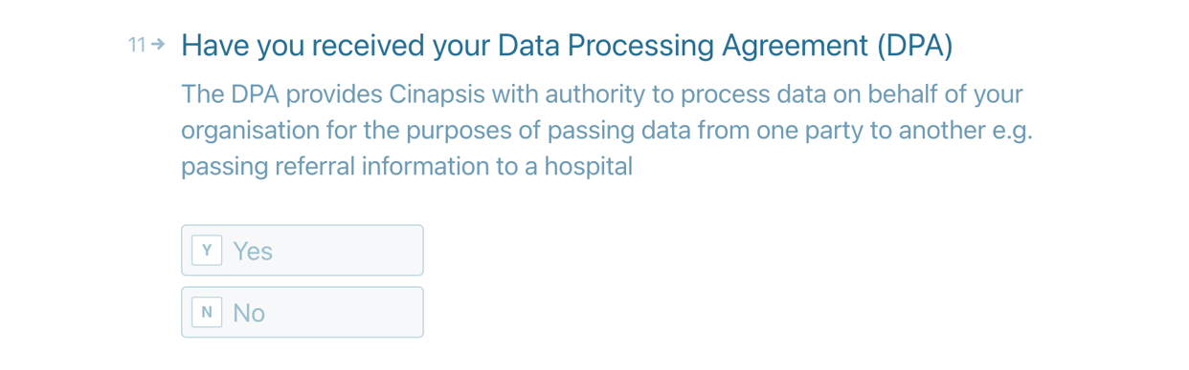
Data Protection Agreement/Protocol (DPA/DPP) (Q11)
19a. Multiples – Select No, Click OK
The DPP/DPA will be submitted by your
HQ - Jump to step 20
19b. All other independent practices – Select Yes, Click OK
Jump to Step 21
19c. Unsure? If you do not know whether your HQ is submitting your DPP or you are waiting for your Caldicott Guardian to review your agreement Select No, Click OK
Jump to step 20

Slide 11
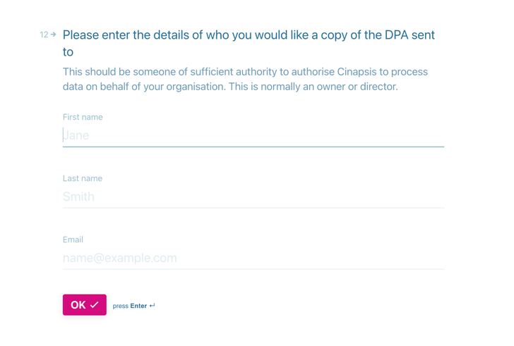
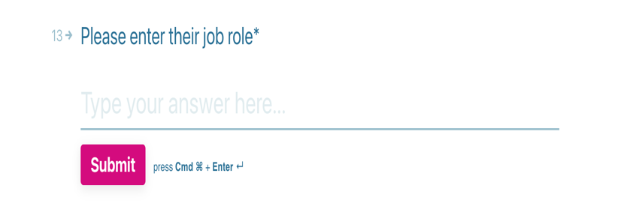
Data Protection Agreement/Protocol (DPA/DPP) – If NO
20a. Multiples?
Q12: Type N/A into the First name, last name, email fields, click OK
Q13: Type HQ Company Name into Job Role field, click OK.
20b: Unsure or those waiting for signatures?
Q12: Type N/A into the First name, last name, email fields, click OK
Q13: Type N/A into Job Role field, click OK.
Waiting Signature - Please forward/chase DPP/DPA with any relevant colleagues for approval.
Unsure if needed – Contact Company HQ, LOC representative.

Slide 12
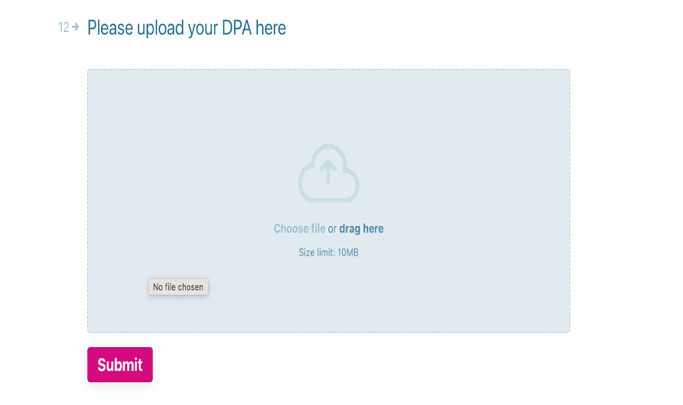
Data Protection Agreement/Protocol (DPA/DPP) – If Yes
21. Locate your previously saved DPP/DPA document on your computer (as per step 0/slide 2).
Drag and Drop your DPP/DPA file
Click Submit.

Slide 13
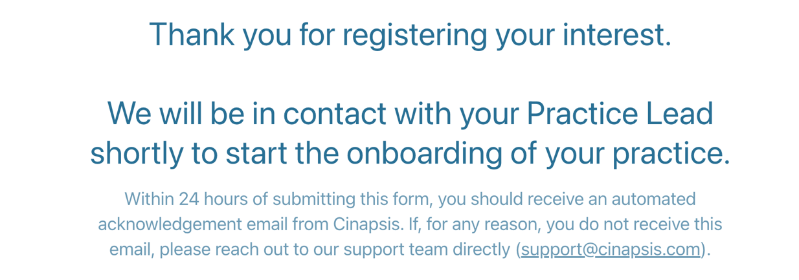
Confirmation of Registration of Interest - COMPLETE
22. Read confirmation, note support email (if needed) and close browser.
Please check for a confirmation email over next 24 hours.
Cinapsis/EeRS Projects Team will chase DPP/DPAs that have not been uploaded.
Please note practices will be in a pending state until DPP and DSPT are confirmed in preparation for Go-Live.

