Slide 1
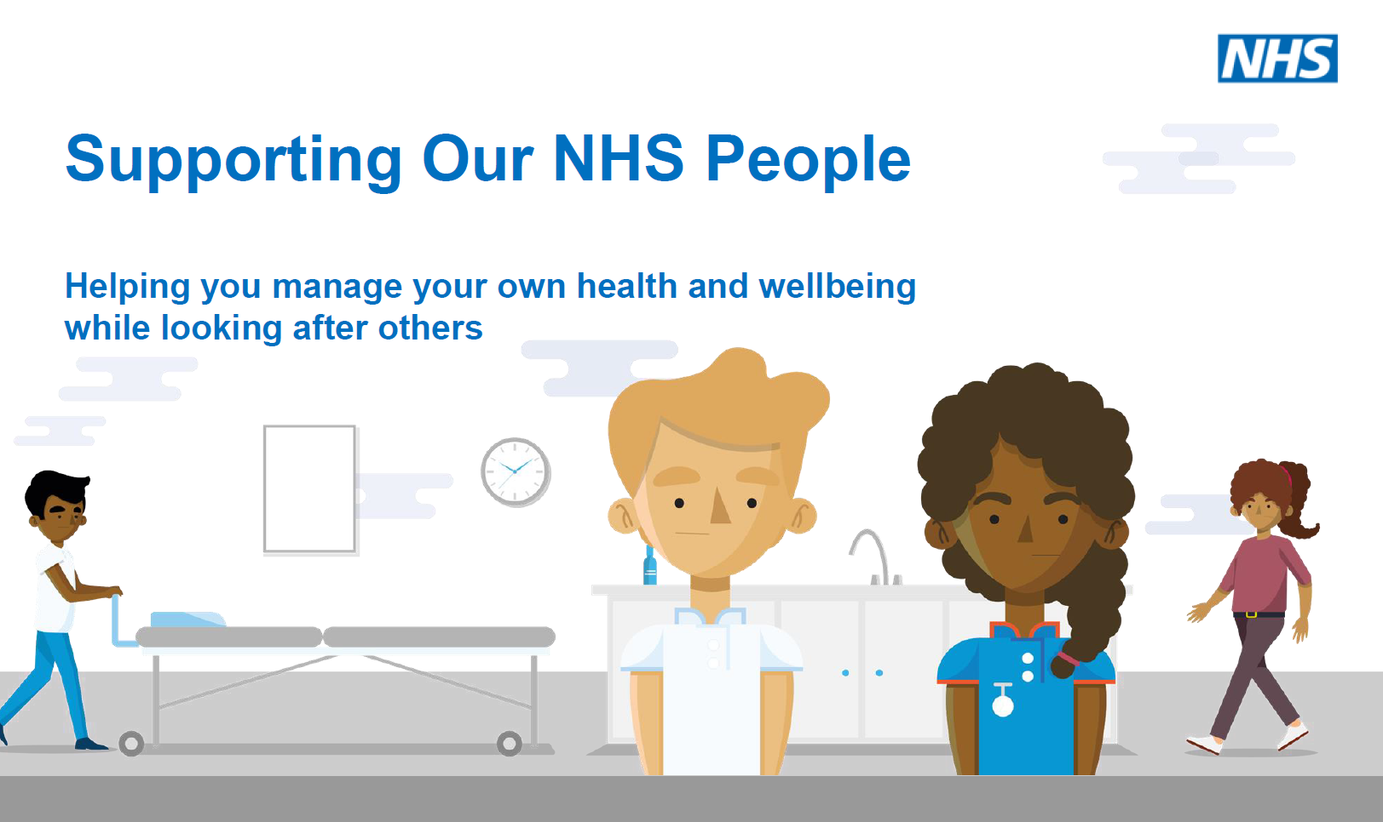
A whole range of wellbeing support offers are available from the NHS People for colleagues across all care sectors including Primary and Social care through helplines, online Apps and coaching.
Please continue to share and promote within your organisations/teams so that colleagues can access the support if they need it
To access these support offers please go to
https://www.england.nhs.uk/supporting-our-nhs-people/

Slide 2

Supporting Our NHS People
Helping you manage your own health and wellbeing while looking after others
Now more than ever, our NHS people deserve a comprehensive package of emotional, psychological and practical support. A range of guides, apps and events to support the wellbeing of you and your team is available at: www.england.nhs.uk/people or contact ournhspeople.hwb@nhs.net
Staff support line: Confidential staff support line, operated by the Samaritans and free to access from 7:00am – 11:00pm, seven days a week.
Call: 0800 069 6222 or Text: FRONTLINE to 85258 for support 24/7 via text
Bereavement support line: Confidential bereavement support line, operated by Hospice UK and free to access from 8:00am – 8:00pm, seven days a week.
Call: 0300 303 4434
Free access to a range of mental health and wellbeing apps including access to
Headspace (free access until 31 Dec 21)
Unmind (free access until 30 Jun 21)
Daylight and Sleepio (NHS staff have up until 31 Mar 21 to sign up and will have free access for 12 months)
You can also access online resources on the recently launched Wellbeing Guardian role, including slides from the launch event, the full guidance and a shorter implementation guide for systems: https://people.nhs.uk/executivesuite/support-in-difficult-times/wellbeing-guardians/

Slide 3
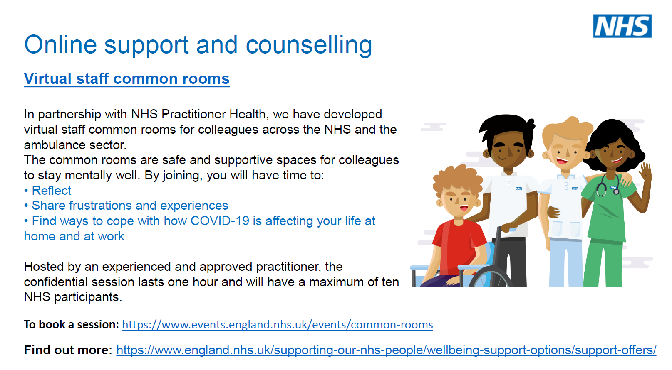

Slide 4
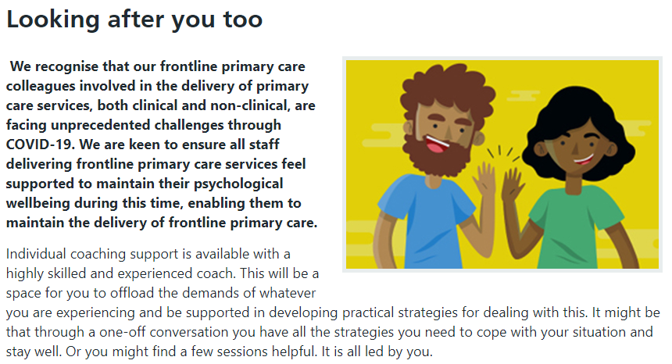
Primary Care Wellbeing

Slide 5
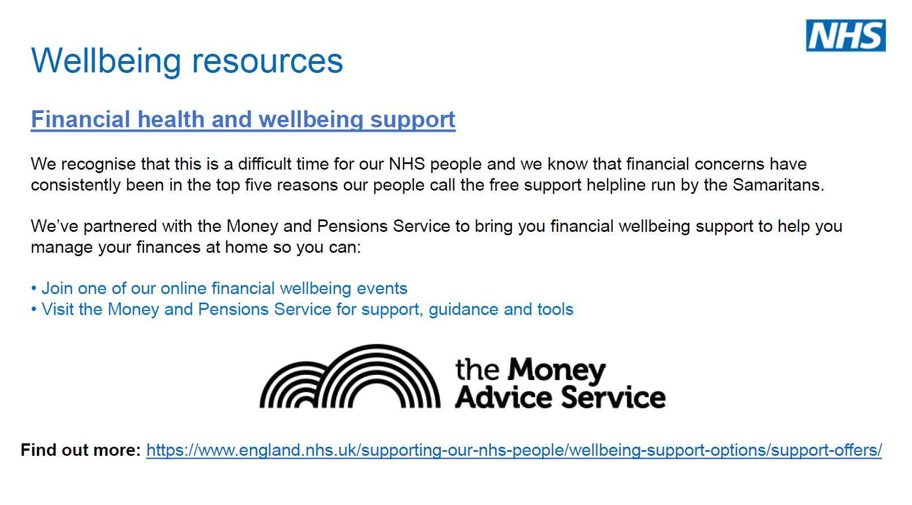

Slide 6
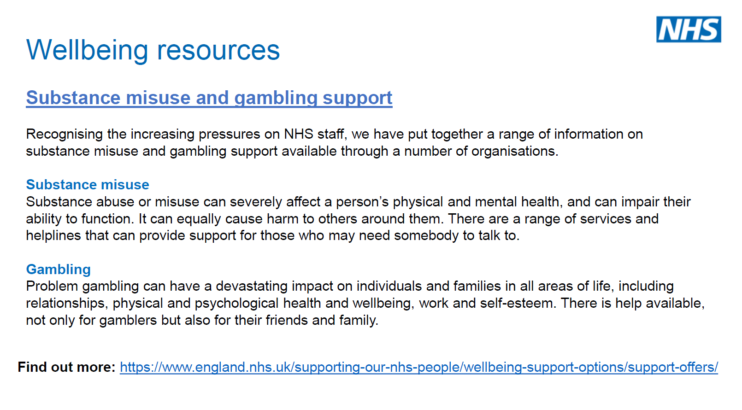

Slide 7
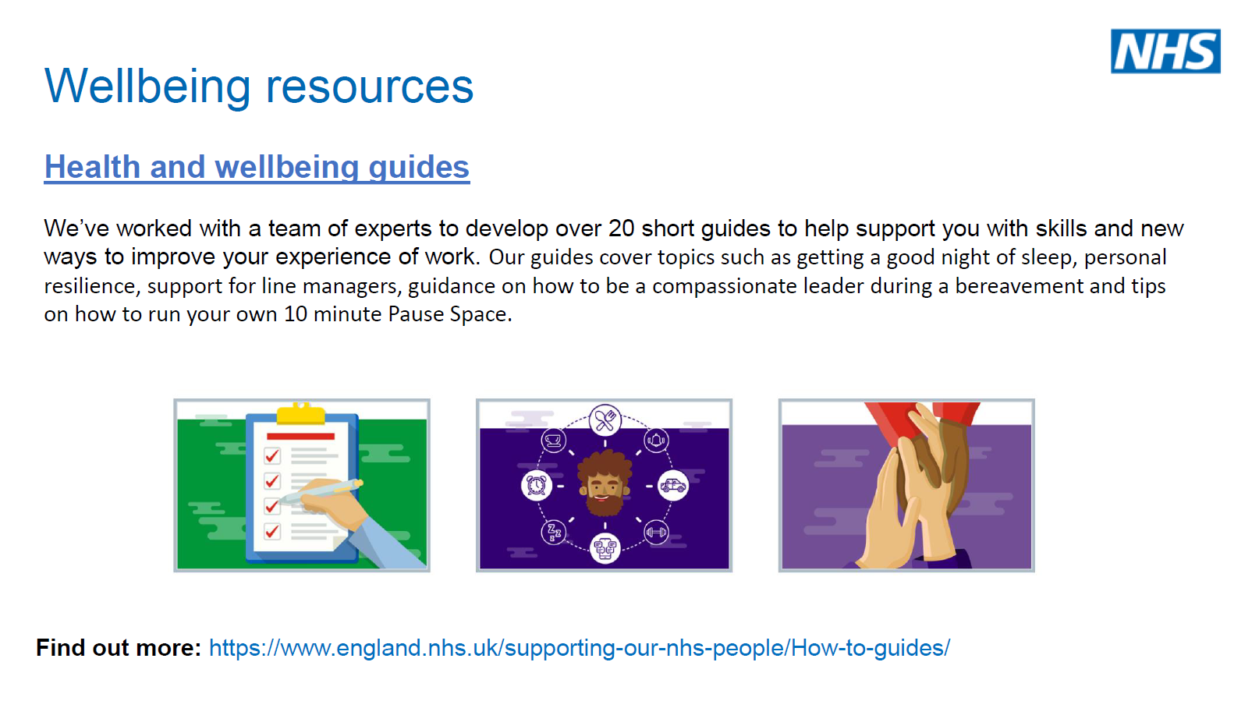

Slide 8
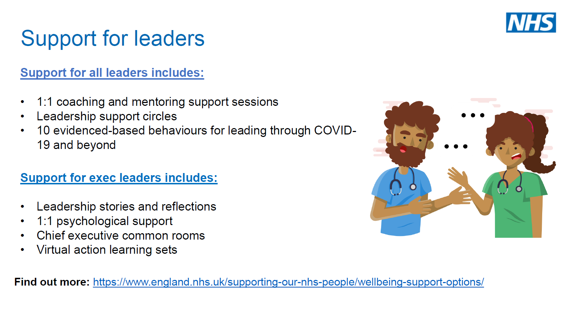

Slide 9
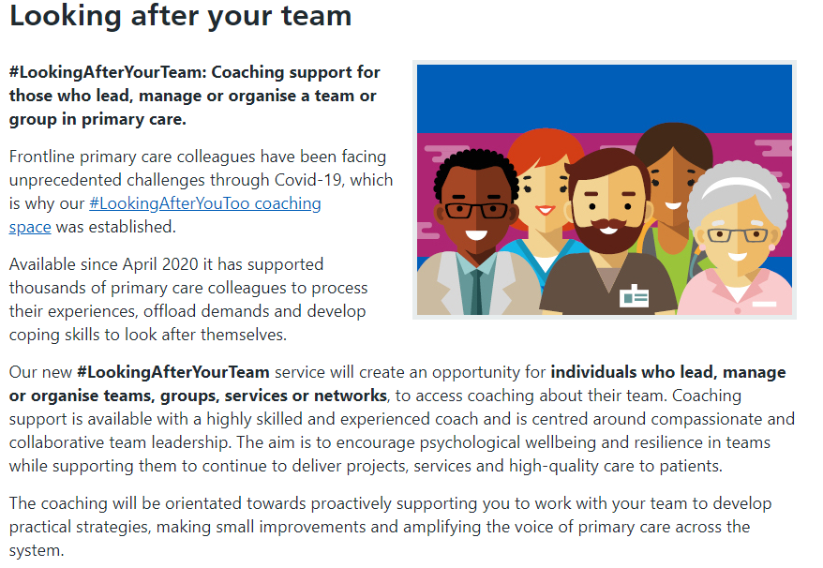
Primary Care Wellbeing (Team)

Slide 10

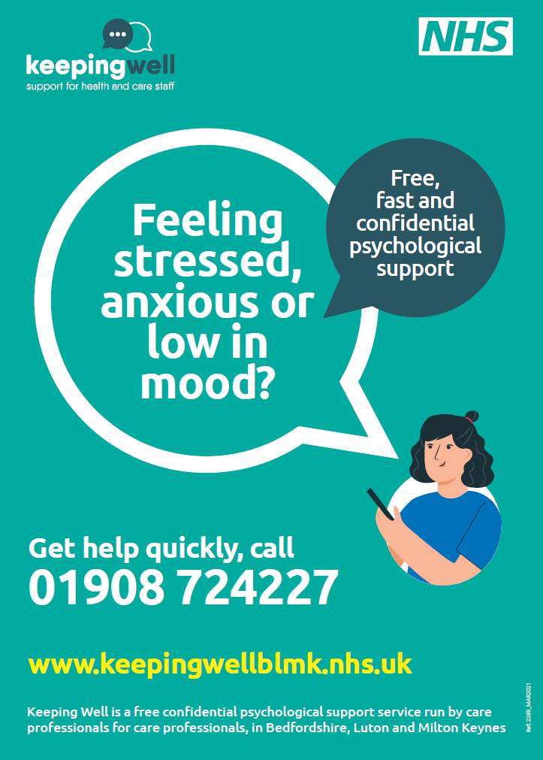
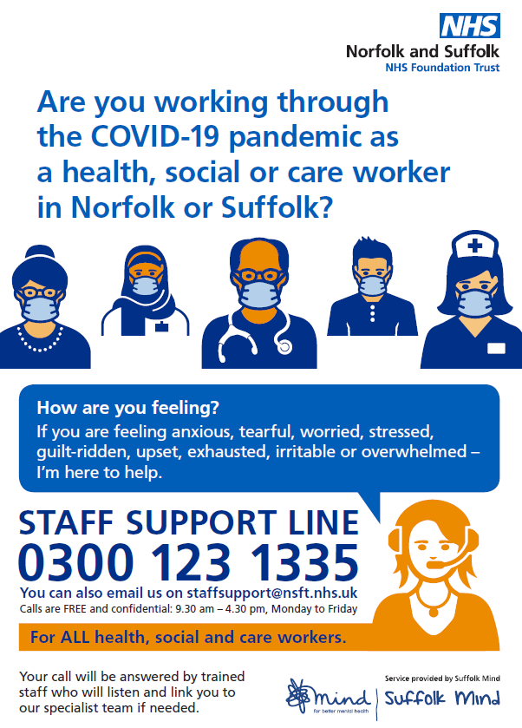

Resilience Hubs
Staff Mental Health Resilience Hubs
Four Hubs established across East Region
Offers proactive outreach and engagement support
Delivers rapid clinical assessment and provides onward referral and care co-ordination to deliver rapid access to mental health services

